Slide 1
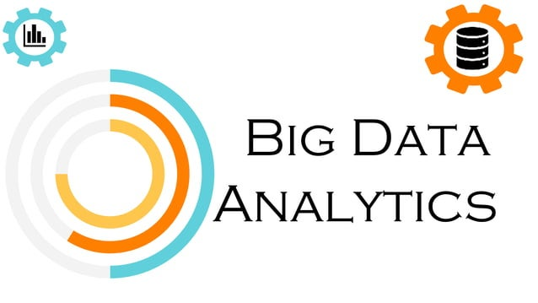

Slide 2
Contents
What is big data?
Types of big data analytics
Characteristics of big data analytics
Process of big data analytics
Benefits of big data analytics
Some Real time application of big data analytics
Advantages/Disadvantages of big data analytics

Slide 3
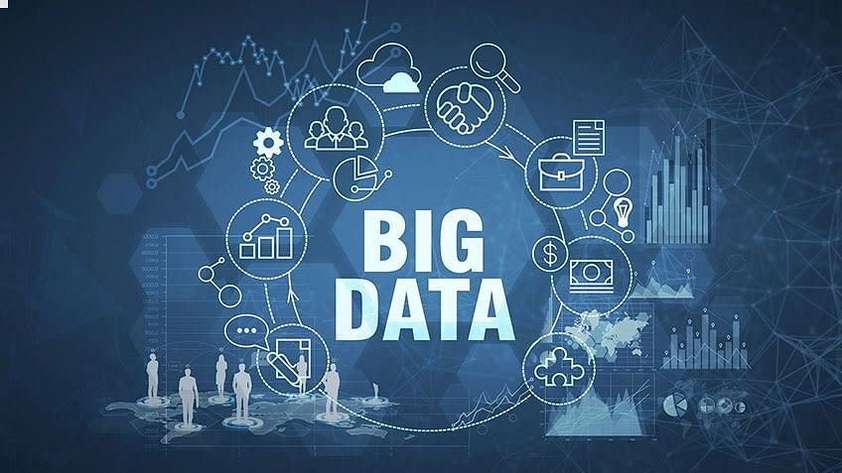
What is big data?
Big Data refers to a huge volume of data, that cannot be stored and processed using the traditional computing approach within a given time frame.

Slide 4
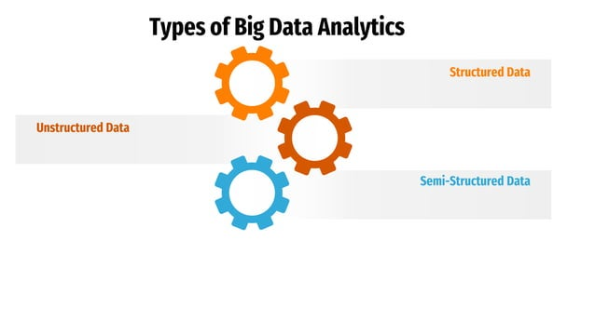

Slide 5
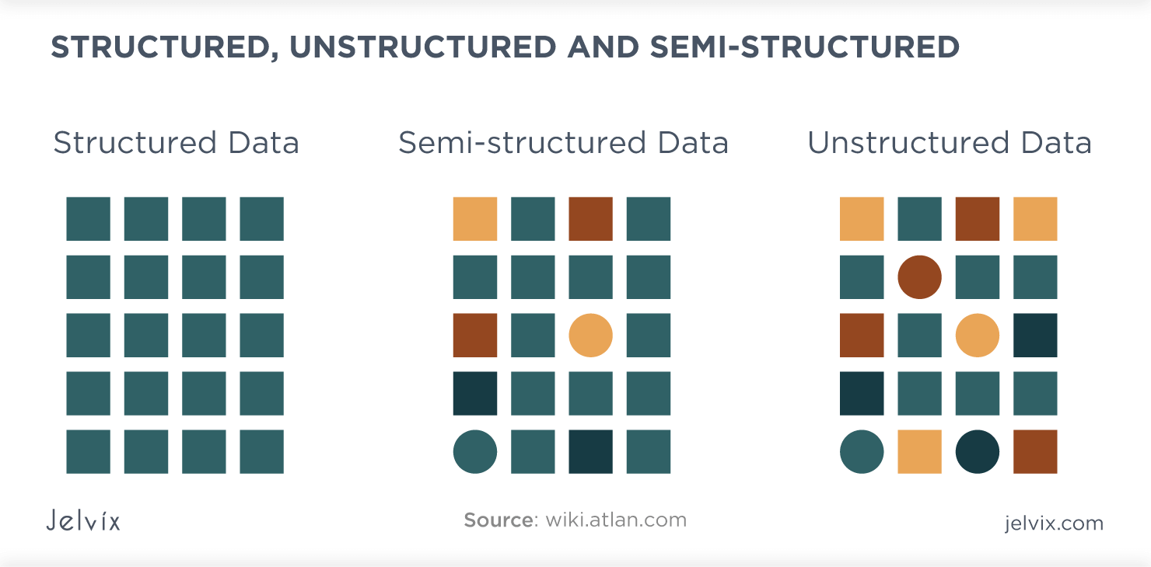
Structured Data
Structured Data refers to the data that has a proper structure associated with it. For example, the data that is present within the databases, the CSV files, and the excel spreadsheets can be referred to as Structured Data.

Slide 6
Unstructured Data
Un-Structured Data refers to the data that does not have any structure associated with it at all. For example, the image files, the audio files, and the video files can be referred to as Un-Structured Data.

Slide 7
Semi-Structured Data
Semi-Structured Data refers to the data that does not have a proper structure associated with it. For example, the data that is present within the emails, the log files, and the word documents can be referred to as Semi-Structured Data.

Slide 8
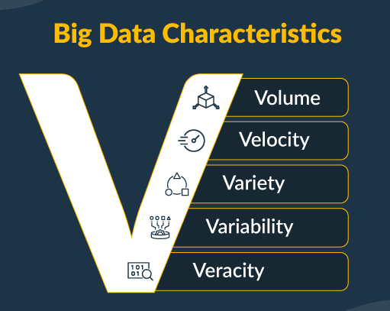
Characteristics of Big Data
Big Data is categorized into 5 important characteristics.
Volume
Velocity
Variety
Veracity
Variability

Slide 9
Volume:
Involves massive amounts of data that exceed the processing capacity of traditional databases.
Velocity:
Deals with the high speed at which data is generated, processed, and analyzed in real-time or near real-time.
Variety:
Encompasses diverse types of data, including structured, semi-structured, and unstructured data from various sources like text, images, videos, and more.
Veracity:
Refers to the uncertainty or quality of data, as big data often comes from multiple sources with varying degrees of accuracy.
Value:
The primary goal is to extract valuable insights and knowledge from the data to make informed business decisions or gain a competitive advantage.

Slide 10
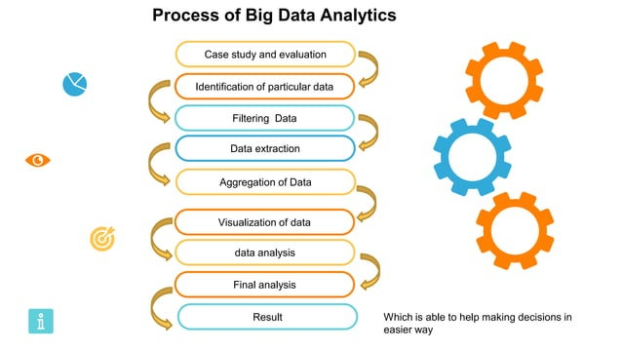

Slide 11

Weather Forecast
Estimates of areas where flooding is likely to be most severe
The strength and direction of tropical storms
The most likely amount of snow or rain that will fall in a specific area
The most likely locations of downed power lines
Estimates of areas where wind speeds are likely to be greatest
The locations where bridges and roads most likely to be damaged by storms
The likelihood of flights being cancelled at specific airports

Slide 12
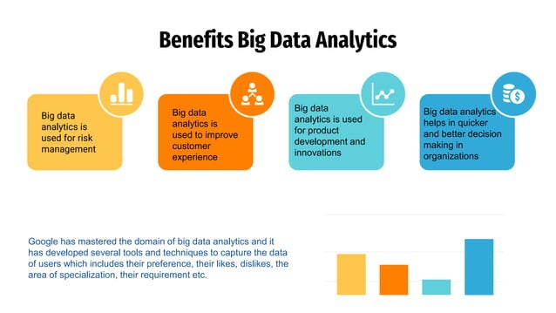
Benefits of Big Data Analytics

Slide 13
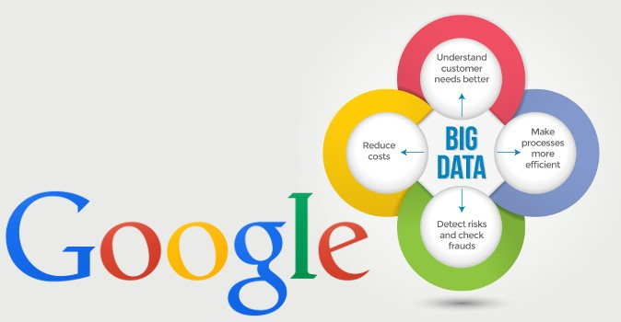
Some Real time application of big data analytics
Google developed several open source tools and techniques that are extensively used in big data ecosystem. With the help of different big data tools and techniques, Google is now capable of exploring millions of websites and fetch you the right answer or information within millisecond's.

Slide 14
Advantages
Informed Decision-Making:
Enables organizations to make informed and data-driven decisions.
Improved Efficiency:
Identifies operational inefficiencies, leading to streamlined processes and improved efficiency.
Enhanced Insights:
Provides deeper insights into trends, patterns, and relationships within data.
Cost Savings:
Identifies areas for cost reduction and optimization, leading to financial savings.

Slide 15
Disadvantages
Privacy Concerns:
Handling large volumes of data may raise privacy issues, especially when dealing with sensitive or personal information.
Security Challenges:
Storing and processing massive amounts of data increases the risk of security breaches and unauthorized access.
Data Quality Issues:
Large datasets may contain errors, inconsistencies, or incomplete information, leading to inaccurate insights.
Complexity of Implementation:
Implementing big data analytics solutions can be complex and require specialized skills, making it challenging for some organizations.

Slide 16
